Slide 1
Discussion Module:
Discussion/Information Only-
Anything less than (n) nodes and (mGB) data can produce spurious results. A capacity planning and tuning lab exists in the advanced class; 14 + nodes, plus driver nodes, production sized data, other.
Topics related to capacity planning
Topics related to tuning
DSE Analytics specific only
DSE Analytics, Capacity Planning and Tuning
Notes:
The goal of this Discussion Module is to detail topics related to DSE Analytics capacity planning and tuning. Comments:
Prerequisites to this discussion include that the attendee is versant on this same topic (capacity planning and tuning) as it pertains to DSE Core.
Tuning exercises on smaller systems with under sized data volumes can produce spurious results; rounding errors, other. For that reason (not having sizeable data and hardware for an overview discussion), this module is not currently accompanied by a lab.
Reference Urls,
https://docs.datastax.com/en/dse/6.0/dse-dev/datastax_enterprise/spark/sparkConfiguration.html
https://docs.datastax.com/en/dse/6.0/dse-dev/datastax_enterprise/spark/sparkCassandraProperties.html
http://spark.apache.org/docs/latest/configuration.html

Slide 2
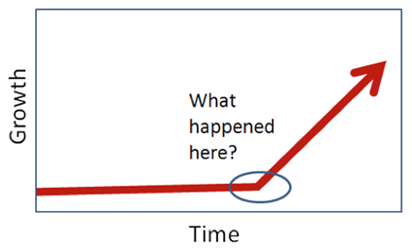
Discussion Lab:
Discuss
Notes:
On the next page we enter a Discussion Lab.

Slide 3


Sizing a (Standard Relational Database):
INSERT
UPDATE
DELETE
SELECT
Planned maintenance
-- Backups
-- Index rebuilds
-- ..
Other overhead
-- Maintaining a warm backup site
-- ..
Other-
Notes:
On the topic of sizing a standard relational database:
Generally (?) it can be summarized as IO/sec (IOPs), read and write
There are system maintenance concerns, but the majority should be daily activities; count and size.

Slide 4

Sizing (Analytics):
(Indexes) of activity/jobs-
Frequency
Concurrency
Spread
Other-
Data feeds (in) Data feeds (out)
..
Notes:
On the topic of sizing an analytics system:
Perhaps a much harder challenge-
Not even a consistent/single unit of measurement for routines; RAM, disk I/O, network load, ..

Slide 5
End of Discussion Lab:
Notes:
End of Discussion Lab-

Slide 6

DSE Analytics: Cap Planning, Tuning-
System tuning
DSE Analytics job tuning
Prod sized data, repeatable test harness, isolation
Frequency, concurrency, spread
One variable; rinse, repeat
http://www.classicgaming.cc/classics/frogger/about
Notes:
On the topic of capacity planning and tuning DSE Analytics, there is system tuning, and statement tuning (analytics routines). Comments:
System tuning involves; disk controller, and disk/data placement, (global) settings in cassandra.yaml, dse,yaml, Linux kernel settings, others.
Depending on your starting point, and the number of errors previously made, system tuning generally yields 5-35% greater performance. It is unlikely you can move a 4 minute DSE Analytics job to a 5 second DSE Analytics job through system tuning.
DSE Analytics jobs can involve the dozens/hundreds/thousands of (end user) initiated DSE Analytics routines that run against the DSE server.
Having captured those statements, we seek to categorize them by; frequency, concurrency, and spread. Reference to the 1900’s video game titled, Frogger.
We seek also to capture the required and observed SLA per statement. If a given statement was executing at 5ms, and increasing 1 ms in execution time per month, that’s a different problem to solve than a statement that jump by an additional 4s of execution time overnight.

Slide 7
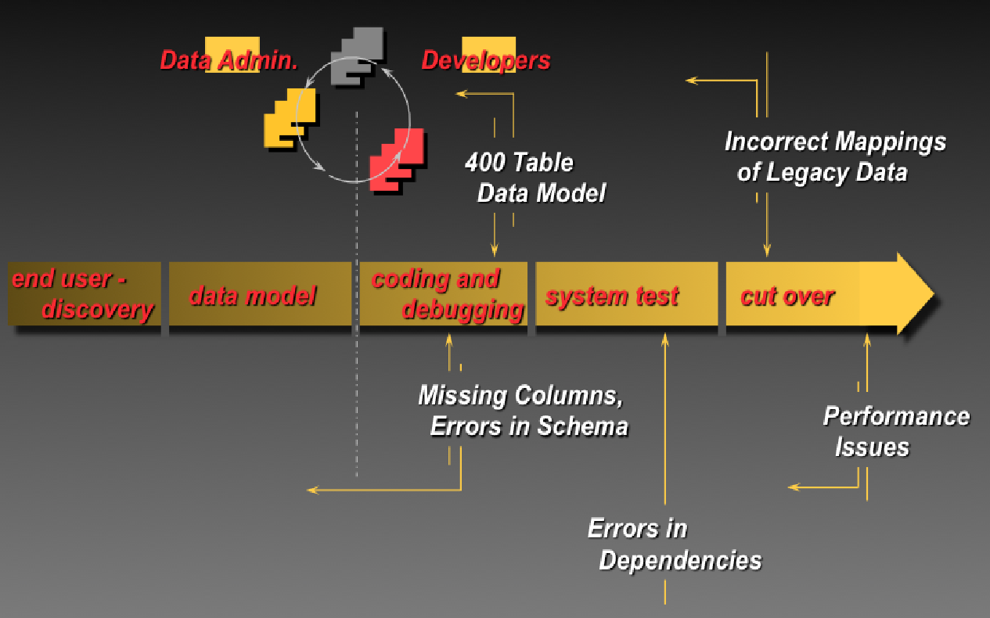
Common SDLC, and Issues
Notes:
Hopefully (best practice), the analytics routine test harness was captured during development and is still active. Comments:
The image above depicts a 5 stage new application development effort software development effort.
It is highly recommended that one develops and test the set of analytics routines on production sized (real, legacy) data after the data and process models are complete, and before any real application development begins. Why ? At this point you can uncover performance issues and related, and change the data and process models while the impact to existing code is measurably lower.

Slide 8




DSE Analytics: DCs, Load isolation
Data Center 1
DB
Data Center 2
DB
Network
Interruption
DB
DB
DB
DB
DB
DB
App
App
Clients
Clients
Notes:
Recall that DSE can isolate workload by groups of nodes, by data center.
So, while the mission critical (low SLA) activities are occurring in DC-1, the DSE Analytics routines can be pushed to DC-2; a nice and easy resource governing and guarantee to the system. The DSE Analytics routines table updates will still have to happen in DC-1. However, the DSE Analytics routines activity in DC-2 should not measurably impact DC-1.

Slide 9
If you don’t have the Analytics Routine Test Harness-
1
System log
DSE Analytics History Server
Application logs
(Other)
DSE Audit Secure subsystem
https://docs.datastax.com/en/dse/6.0/dse-admin/datastax_enterprise/security/secAuditEnable.html
Developers
This is something someone should have created/maintained
Reverse engineering is not forecasting, signing your name to something
2
Notes:
The next two pages discuss (reverse engineering) the analytics routine test harness if you do not possess it. Comments:
Improperly done, researching/developing this test harness can become intrusive performance wise.
The DSE Analytics History Server can be of benefit here.

Slide 10

Start working the (graph)
Not cost effective to fix every DSE Analytics routine/job; Pick the top n% that you have time for
Duration
Frequency of Analytics Routine/Job
Notes:
It’s not cost effective to tune all (1000) queries; pick the most offensive and work down the list.
Also create a list of every index in place, and start associating those indexes with known queries. IF you aren’t using an index (but still must maintain it), drop the index.

Slide 11
DSE Analytics
Configuring, Startup and more
Notes:
Entering a section on configuring, and startup.

Slide 12
DSE Analytics: How Spark is started
/etc/default/dse file
By default setup as part of the package installers
A copy if you were to manually do it is in the tarball
-- <tar extract location>/resources/dse/conf/dse.default
-- If creating a custom init script copy to /etc/default or have script point
to a custom location
Allows you to turn on/off on startup
-- Spark
-- DSEFS is not configured here
If not using init script need to pass in flags , -k for spark
Notes:
No additional notes-

Slide 13
DSE Analytics: dse.yaml
Found in either,
/etc/dse/dse.yaml
<install_dir>/resources/dse/conf/dse.yaml
Spark cluster and application statistics being collected
Initial spark worker resources (as a percentage after C*)
Configuration change in 6.0.0, much more granular
Spark security and encryption
Always on SQL Server
Spark readiness check
DSEFS (and its configuration)
Spark Auditing (more as C* but spark-sql audit shows up)
Solr query paging (key for SearchAnalytics mixed mode)
Notes:
No additional notes-

Slide 14
DSE Analytics: dse-spark-env.sh
Found in either,
/etc/dse/spark/dse-spark-env.sh
<install_dir>/resources/spark/conf/dse-spark-env.sh
Rarely touched
Mainly for defaults regarding running Spark with DSE
Most environment changes are done in spark-env.sh
Notes:
No additional notes-

Slide 15
DSE Analytics: spark-env.sh
Found in either,
/etc/dse/spark/spark-env.sh
<install_dir>/resources/spark/conf/spark-env.sh
Set default CORES and MEMORY across
Workers
Executors
Master
Driver
This allows to fine tune memory and processors rather than the generic % found in the dse.yaml
Notes:
No additional notes-

Slide 16
DSE Analytics: spark-defaults.conf
Found in the usual Spark configuration locations
Pass in default Spark properties
If using encryption specify settings here
Can use a different file to set defaults for various apps
-- dse spark-submit --properties-file new-properties-file
-- But there can be only one, if you have something in the
spark-defaults.conf but pass in new file it will ignore
the spark-defaults.conf
-- Property file can be whitespace or = demarcation of property to value
Available properties to configure are in,
http://spark.apache.org/docs/latest/configuration.html#available-properties
Defaults, what you want for the majority of applications
-- Using secondary properties file can set per app as you pass in the job
-- Any property can also be a configured individually within your app
Notes:
No additional notes-

Slide 17
DSE Analytics: spark-defaults.conf
Security settings
If Cassandra authorization/authentication turned on
-- spark.cassandra.auth.username
-- spark.cassandra.auth.password
If using DSEFS with security
-- com.datastax.bdp.fs.client.authentication=basic
-- com.datastax.bdp.fs.client.authentication.basic.username
-- com.datastax.bdp.fs.client.authentication.basic.password
-- Other settings and restrictions apply, see
http://docs.datastax.com/en/dse/6.0/dse-admin/datastax_enterprise/analytics/authDsefs.html
Notes:
No additional notes-

Slide 18
DSE Analytics
Tracking, Auditing
Notes:
Entering a section on tracking, auditing.

Slide 19
DSE Analytics: Tracking, Auditing
User interface including stdout/stderr
Change the log level of various components of Spark
-- logback-spark.xml
-- logback-spark-server.xml
-- logback-spark-executor.xml
-- Other
Audit logging in the dse.yaml
--audit_logging_options
Spark cluster info in the dse.yaml
-- spark_cluster_info_options
Spark application info in the dse.yaml
spark_application_info_options
Notes:
No additional notes-

Slide 20
DSE Analytics
Performance
Notes:
Entering a section on performance.

Slide 21
DSE Analytics: Where to Start
Issues submitting and running jobs-
Spark Master UI
Spark Work UI
stdout/strderr
Spark Application UI
Log files
-- system.log
-- /var/log/spark … (by default)
-- master.log
-- worker.log
-- (application logs)
OpsCenter for overall cluster health
Submit job using the –verbose/-v flag for more output
Notes:
No additional notes-

Slide 22
DSE Analytics: Spark Issues
Problems with Memory-
OOM
More helps speed things
Maybe need more systems in the cluster
Problems with the cores-
Jobs can’t start
Jobs waiting to start
Jobs take a long time to run
Maybe need more systems in the cluster
Problems with code-
Classpath issues
Inefficient code
Doing a lot of data shuffling
Notes:
No additional notes-

Slide 23
DSE Analytics: Memory Issues
Large amount of data on disk (rdd directory) when you were not expecting
-- Spark tries to do everything in memory, then will spill to disk
-- If expected everything to fit into memory, why is it spilling
-- Look at the application UI and the storage details
-- Look at dag schedule, etc
Just need more memory
-- Add nodes
-- Adjust memory settings for Spark, don’t starve DSE Core JVM
-- How you are programming
.. Collecting and sending to driver, and back out again excessively?
.. Filter early, often
.. Spark will optimize job, but can only do so much
Notes:
No additional notes-

Slide 24
DSE Analytics: OOM Errors-
First question is where-
DSE
Master
Executor (should not happen)
Driver/Application
Depending on where, adjustments you can make
Adjust memory for Spark, don’t starve DSE
Set more appropriate settings for driver, and executor in your Spark configuration
-- Default if it is for all jobs
-- Specific job as only if ..
-- Driver memory settings for different jobs
Notes:
No additional notes-

Slide 25
DSE Analytics: Cores
Jobs in waiting state, resource are not available
Maybe this is ok, lot of jobs queued and you just want to wait
Architectural decision; set resource to one job to get done faster, or partial resources to jobs so multiple can run at the same time
Many executors with smaller memory vs few executors with lots of memory each
Turning on resource sharing may be an appropriate action
Could have everything fully utilized because of a lot of open streams jobs that never close
Could be you are over allocating cores to a job, use your config to adjust
Jobs that are taking a long time to complete
Find where the bottleneck is I.e you are pulling data from an external system and that is as fast as it can send
Code Optimization as the solution? Number one thing to fix
Notes:
No additional notes-

Slide 26
DSE Analytics: Code
Unnecessarily shuffling data
Cache appropriately at the right level
Filter early and often and collect late
Manipulate/lift only the data needed
Pulling data from external systems, so one worker is not a bottleneck; I.e. from RDBMS not using a strategy that allows partitioning. (One worker has to pull all data, then transfer it to other workers, so they can then manipulate the data.)
Coding practices and algorithms, expert/peer code reviews
Performance test with real data loads, no surprise when going into production
Notes:
No additional notes-

Slide 27
DSE Analytics: Code
Writing to DSE Core, code to use single partition batches; don’t have to wait on other mutations
Utilize fewer coordinator nodes
Upgrade from older DSE/DSE-Analytics, check release notes
(Recompile code as APIs may not be backwards compatible)
Notes:
No additional notes-

Slide 28
DSE Analytics: Miscellaneous
Classpath issues
Submitting a fat jar that should have all classes; overhead but puts everything on the path
Local directory for dependent jars passing in the -jars flag
-- jar right version on all machines in the cluster
-- Use a shared file system, DSEFS
-- Submit in cluster mode, jars passed by driver
Max result size exceeded
spark.driver.maxResultSize is 1GB by default
http://spark.apache.org/docs/2.0.2/configuration.html
May need to set higher
Notes:
No additional notes-

Slide 29
DSE Analytics: Lastly-
If you can’t find the issue using the UI, logs, etc. then it may be time to dive deeper
Get a thread dump
Get a heap dump
Understanding code and what it is suppose to be doing is a must; object that is 6GB in size may be expected
Useful tools
Memory analyzer for heap dumps http://www.eclipse.org/mat/
FastThreads.io for thread dumps http://fastthread.io/
Samurai http://samuraism.jp/samurai/en/index.html
Notes:
No additional notes-

Slide 30
End of Module:
Notes:
End of Discussion Module-

Slide 31
Additional Detail:
Notes:
The remaining content may be read “extra credit”, as time allows.

Slide 32
DSE Analytics: Enabling Logging
Find/review the following files
-- audit.log
-- master.log, worker.log
-- system.log
-- stderr, stdout
Create a new table in DSE Core
Turn on
-- Auditing query level
-- Trace in logback files
-- spark_cluster_info_options
-- spark_application_info_options
Restart system
Load data into the new table from Spark REPL
val data = spark.read.format ...
Review all the files again
Notes:
No additional notes-

